Slide 1
Detection and categorization of fake news with hybrid approach
Team members:
Hemathi d (211419104102)
Ishani s (211419104107)
Madhumitha v (211419104157)
GUIDE:
DR.T.JACKULIN M.E.,PH.D.,
ASSOCIATE PROFESSOR

Slide 2
INTRODUCTION
The spread of fake news and misinformation on social media has become a major concern in recent years.
Social media platforms have made it easy for anyone to share information with a large audience, which has led to the proliferation of false and misleading stories.
These stories can be used to manipulate public opinion and can have serious consequences, such as causing panic and chaos among the population.
There are three types of fake news detection solutions: content-based, social context-based, and knowledge-based approaches. We propose a novel hybrid fake news detection system that combines linguistic approach and knowledge-based approaches and it also finds the category of the fake news.

Slide 3
INTRODUCTION
A linguistic approach involves analyzing the language and structure of the text to identify characteristics that are indicative of fake news.
This can include things such as sentiment analysis, language style, syntactic complexity, readability, semantic similarity.
A knowledge-based approach uses external knowledge sources to verify the credibility of the news.
This can include things like fact-checking and credibility assessment. Furthermore, results from an evaluation on a fake news dataset show that the proposed system employing both types of features can achieve an accuracy of more than 94.4%, which is higher than that obtained by separately employing linguistic features (i.e., accuracy=89.4%) and fact-verification features (i.e., accuracy=81.2%).

Slide 4
Existing system
As previously discussed, the existing fake news detection solutions are either linguistic-based or knowledge-based, or social context-based approach to detect fake news detection
Some existing solutions rely on ontologies in order to model fake news domain knowledge, which can be then used to distinguish fake from real news content.
The existing solution's accuracy is 89.4% (Linguistic Approach) and 81.2% (Knowledge-based approach), which is lower than the proposed system's.

Slide 5
disadvantages
Hosseinmoltagh and Paplexakis investigated the problem of identifying the different types of fake news with high accuracy.
Logistic regression is a linear algorithm used for binary classification problems.
The objective of this algorithm is to build a training model that is used to predict the class of the target variable, which is used by the decision tree to solve the classification problem.

Slide 6
Proposed system
We propose a hybrid fake news detection system that takes advantage of both linguistic-based and knowledge-based approaches. and it also finds the category of the fake news
The evaluation results show that the proposed combination of features records more than 95% accuracy
The proposed fake news detection system consists of two phases, namely training and testing.
In the training phase, the feature extracting task extracts a set of relevant features from the training dataset, which are then fed to several machine learning algorithms to build a fake news detection model.
In the testing phase, the detection model is applied on test data to decide whether the provided news articles are real or fake. Presents the overall architecture of the proposed fake news detection system.

Slide 7
advantages
Hybrid linguistic and knowledge-based fake news detection system that combines linguistic features and a novel set of knowledge-based features, called fact-verification features.
The proposed system only employs eight features, which is less than most of the state-of-the-art approaches.
The evaluation results show that the proposed combination of features records more than 94% accuracy for fake news detection, and allows an increase of more than 7% compared to linguistic-based features.

Slide 8
LITERATURE SURVEY
TITLE | YEAR | AUTHOR | METHODOLOGY | MERITS AND DEMERITS | FUTURE SCOPE
A novel hybrid multi-thread metaheuristic approach for fake news detection in social media. | 2022 | Gungor Yildirim | Hybrid multi-thread (HMT) | MERITS: Optimization-based approaches can offer flexible and efficient solutions for fake news detection DEMERITS: A long runtime and inefficient use of search space | Fake news detection through an ensemble model that contains the HMT and a pre-trained deep network, to improve the results.

Slide 9
LITERATURE SURVEY
TITLE | YEAR | AUTHOR | METHODOLOGY | MERITS AND DEMERITS | FUTURE SCOPE
A Systematic Literature Review and Meta-Analysis of Studies on Online Fake News Detection. | 2022 | Robyn C. Thompson , Seena Joseph and Timothy T. Adeliyi | CNN and LSTM | MERITS: The study employed a systematic review and meta-analysis methodology to quantitatively evaluate the fake news detection methods. DEMERITS: CNN is an old algorithm | The study is relying on literature in only the Web Of Science database, further research that includes numerous databases and additional performance evaluations other than accuracy is advised.

Slide 10
LITERATURE SURVEY
TITLE | YEAR | AUTHOR | METHODOLOGY | MERITS AND DEMERITS | FUTURE SCOPE
Evaluating the effectiveness of publishers’ features in fake news detection on social media. | 2022 | Ali Jarrahi, Leila Safari . | Sentence-level convolutional neural network (SLCNN) | MERITS: It proposed the CreditRank algorithm, which considers the activity history and credit rank of publishers in the network DEMERITS: CNN algorithm did not performed well | Intend to extract and study more features from publishers and their interconnections

Slide 11
LITERATURE SURVEY
TITLE | YEAR | AUTHOR | METHODOLOGY | MERITS AND DEMERITS | FUTURE SCOPE
Fake News Detection Techniques on Social Media: A Survey | 2022 | Ihsan Ali , Mohamad Nizam Bin Ayub, Palaiahnakote Shivakumara, Nurul Fazmidar Binti Mohd Noor | Naïve Bayes Classifier, Support Vector Machine (SVM), Semantic Analysis | MERITS: Fake news can be identified by combining more algorithms DEMERITS: Only applicable for twitter datasets | The project must go to great depth about how to broaden the scope of the area to serve additional uses in addition to news monitoring

Slide 12
LITERATURE SURVEY
TITLE | YEAR | AUTHOR | METHODOLOGY | MERITS AND DEMERITS | FUTURE SCOPE
Fake News Detection in Social Networks using Machine Learning: A Review | 2021 | Sonali Raturi, Amit Kumar Mishra and Srabanti Maji | ML Algorithms: Support Vector Machine , Stochastic Gradient Descent | MERITS: Conspicuous achievement in detection of false news or fake posts with the use of various Machine learning approaches DEMERITS: Dynamic features of hoax news in social media is causing problem in classification of false news. | To robotize repetitive tasks and increasing productivity

Slide 13
LITERATURE SURVEY
TITLE | YEAR | AUTHOR | METHODOLOGY | MERITS AND DEMERITS | FUTURE SCOPE
Fake News Detection from Online media using Machine learning Classifiers | 2021 | Shalini Pandey, Sankeerthi Prabhakaran, N V Subba Reddy and Dinesh Acharya | Logistic Regression, Naïve Bayes, Decision Tree, SVM. | MERITS: The project results in max accuracy of 80% DEMERITS: Decision tree doesn’t yield efficiency | The project can be further extended as a practical application that would be ready to take any input irrespective of language and determine if it‟s fake or real.

Slide 14
LITERATURE SURVEY
TITLE | YEAR | AUTHOR | METHODOLOGY | MERITS AND DEMERITS | FUTURE SCOPE
Fake News Detection Using Machine Learning Approaches | 2020 | Z Khanam , B N Alwasel , H Sirafi and M Rashid | KNN,Random forest, SVM and Naïve Bayes and voting classifiers | MERITS: The project results in max accuracy of 90% DEMERITS: Decision tree doesn’t yield high efficiency and only for twitter datasets | The scope of this project is to cover the political news data, of a dataset known as Liar-dataset, it is a New Benchmark Dataset for Fake News Detection and labeled by fake or trust news

Slide 15
LITERATURE SURVEY
TITLE | YEAR | AUTHOR | METHODOLOGY | MERITS AND DEMERITS | FUTURE SCOPE
Fake News Detection Using Machine Learning Algorithms | 2020 | Uma Sharma, Sidarth Saran, Shankar M. Patil | Python and its Sci-kit libraries | MERITS: The model is trained using an appropriate dataset and performance evaluation is also done using various performance measures. DEMERITS: Accuracy is 75% | Latest data will be kept in a database using Web Crawler and online database.

Slide 16
LITERATURE SURVEY
TITLE | YEAR | AUTHOR | METHODOLOGY | MERITS AND DEMERITS | FUTURE SCOPE
A smart System for Fake News Detection Using Machine Learning | 2019 | Anjali Jain, Harsh Khatter , AvinashShakya | Naive Bayes , Support Vector Machine (SVM), NLP | MERITS: These approaches yield maximum accuracy of 93.5% DEMERITS: The mentioned system detects the fake news on the based on the models applied. | The efficiency and accuracy of the prototype can be enhanced to a certain level, and also enhance the user interface of the proposed model.

Slide 17
Problem statement
The proliferation of fake news on social media and other online platforms is a growing concern that has significant implications for public opinion, public safety, and overall trust in information. Despite efforts to counter it, fake news continues to spread quickly and easily, often having a profound impact on public opinion and behavior. The aim of this project is to develop an effective and efficient solution for detecting and categorizing fake news using a combination of machine learning algorithms and knowledge-based approaches. The goal of the project is to provide a tool that can assist users in making informed decisions about the news they consume and to improve overall trust in information by reducing the spread of fake news on social media and other online platforms.

Slide 18
development environment
H/W SYSTEM CONFIGURATION:
Processor - Intel i3,i5,i7, AMD Processor
RAM - Above 6 GB
Hard Disk - Above 500 GB
S/W SYSTEM CONFIGURATION:
Operating System - Windows 7/8/10
Front End - HTML ,CSS
Scripts - R language
Tool - Python

Slide 19
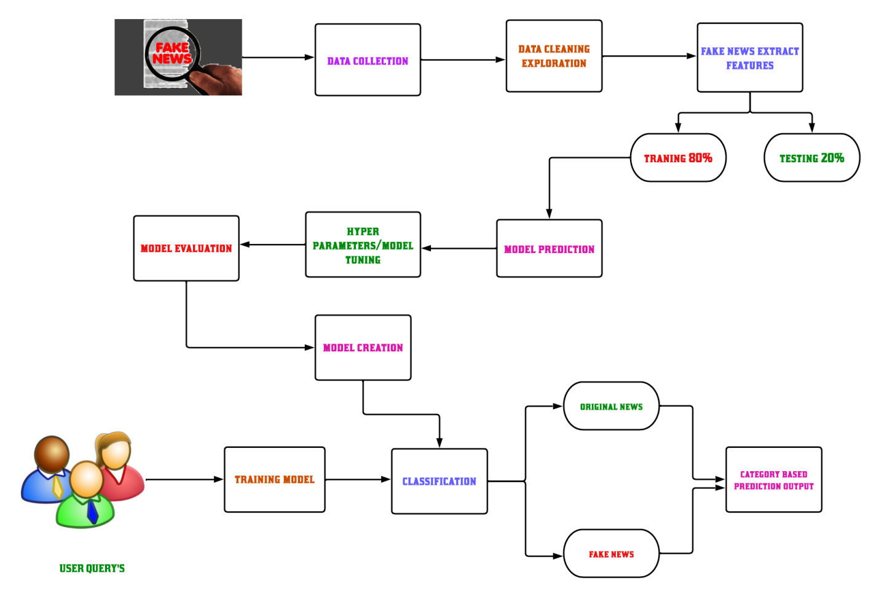
SYSTEM Architecture

Slide 20
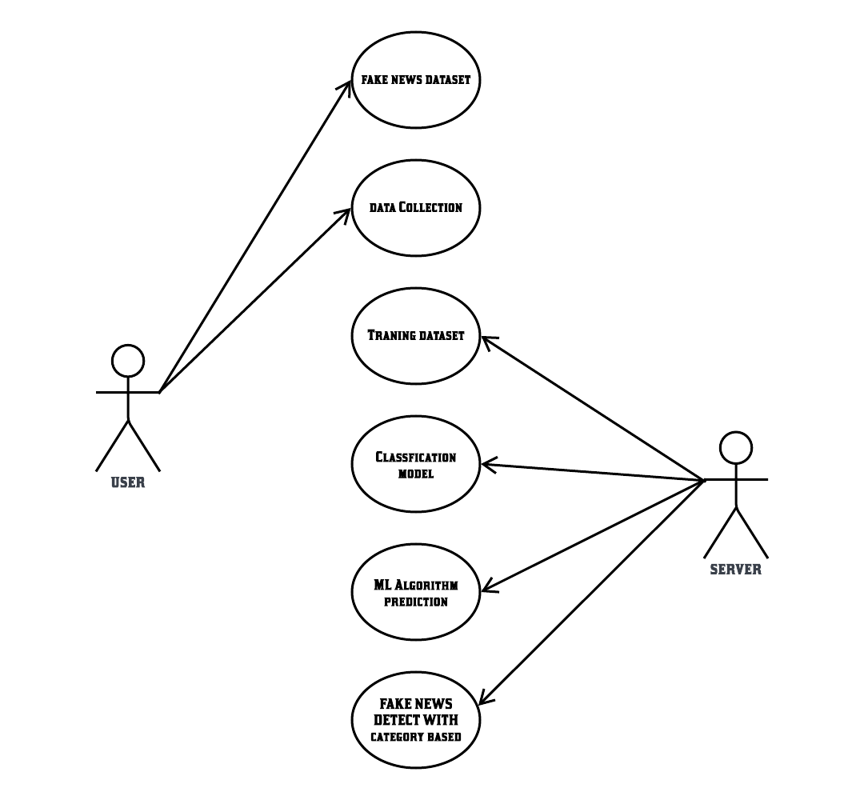
uml diagrams: usecase diagram

Slide 21
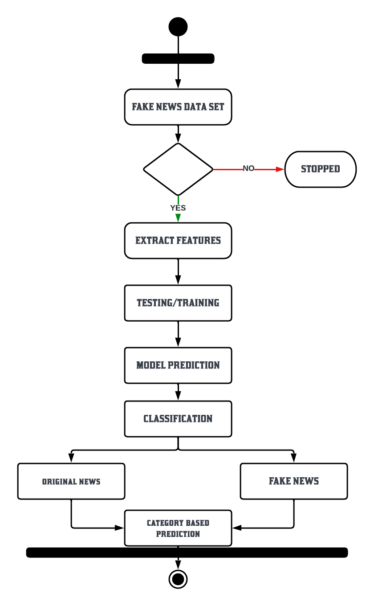
uml diagrams: activity diagram

Slide 22
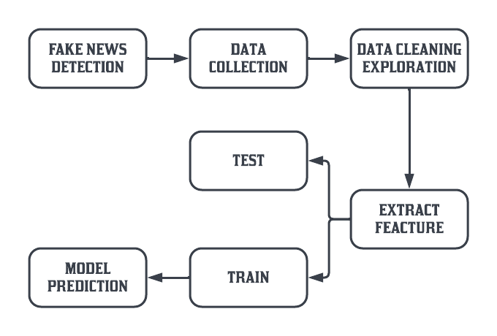
dataflow diagram level 0:

Slide 23
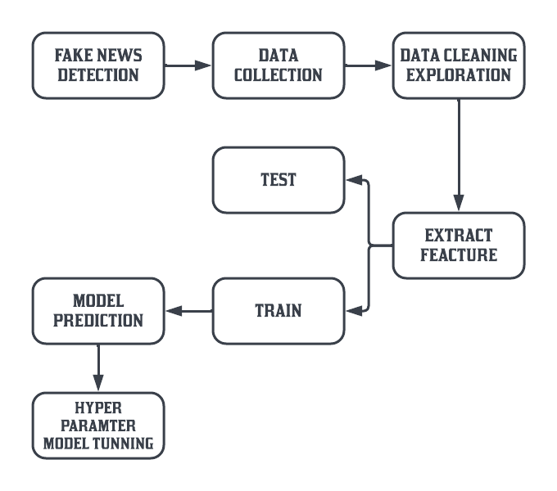
dataflow diagram level 1:

Slide 24
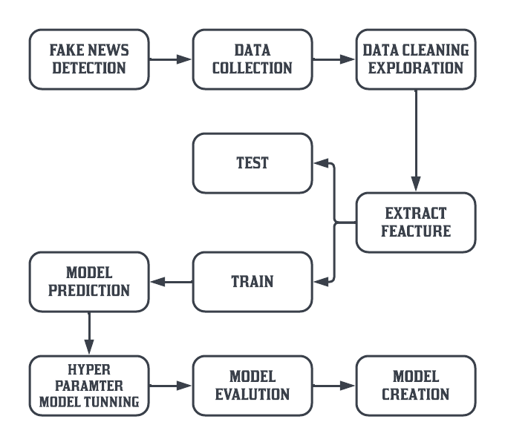
dataflow diagram level 2:

Slide 25
Modules description
MODULES LIST:
Data collection
Data preprocessing
Feature extraction
Modeling Creation with Random Forest
Hyper parameter Tuning

Slide 26
Module 1
DATA COLLECTION Data is the prime ingredient of this project, as these data features are extracted using Natural Language Processing. By using these features of the data, Machine Learning Algorithms are trained and models are created. In this proposal, we have news with equal proportionality of fake and real. Data is saved in Comma Separated Value format. This data set is divided in the training and testing of algorithms.

Slide 27
Module 2
DATA PREPROCESSING The six-label classification problem was translated into a binary classification problem with True and False labels for the proposed scheme. In addition, only the news headline was used as an input for classification. Thus, in the preprocessing stage, the labels were first mapped using the above-mentioned mapping, after which only the labels and news statement columns were extracted from the dataset and saved in .csv format for future use. Following the preprocessing, we were able to obtain the following three cleaned files: • train.csv

Slide 28
Module 3
FEATURE EXTRACTION The following feature extraction method is used to help machine learning models gain insights from news headlines: Count Vectorizer: First, the English stopwords were stripped from all of the news headlines using scikitlearn's Count Vectorizer, and then they were tokenized using spaces and punctuation marks as the delimiter. After all of the headlines had been tokenized, a sparse matrix of all of the news headlines as rows and the tokens as columns was restored. In addition to their morphological use, a number of n-grams were returned to make the tokens reflect the sense in which they were used.

Slide 29
Module 4
MODELING CREATION WITH RANDOM FOREST Logistic Regression, Random Forest Classifier, Naive Bayes, SVM Classifier, and voting classifier were the models used for training. The features extracted from the Count Victories are used to train the models. After that, using Grid Search CV and a 5-hold out cross validation set, all of the models were hyper parameter tuned for all of the different possible parameters. The aim of this hyper parameter tuning was to boost the models' f1-score. After the models were fine-tuned, they were evaluated on a test range, and evaluation metrics for the models were determined.

Slide 30
Module 5
HYPERPARAMETER TUNING Parameters that define the model architecture are referred to as hyperparameters and thus the process of searching for the ideal parameter is referred to as hyper parameter tuning. We have used Grid Search CV to tune the parameter of each algorithm. The grid of values of each parameter is given as input and Grid Search CV will methodically build and evaluate a model for each combination of algorithm parameters specified in a grid. The model with the best parameter value is given as output.

Slide 31
Algorithm
Logistic Regression
Random Forest
Additional tree discriminant
XG BOOST

Slide 32
objective
Thus, identifying whether a piece of content is fraudulent or authentic has become a crucial area of research.
In this paper, we propose a novel hybrid fake news detection system that combines linguistic and knowledge-based approaches and inherits their advantages. It does this by using two different sets of features, linguistic features and a novel set of knowledge-based features, called fact-verification features, that comprise three types of information, namely, reputation of the website where the news is published, coverage, number of websites about the news, i.e., true or false and additionally.

Slide 33
scope
Under each category, some of the approaches from the literature that have been deemed to be the most important in the last fifteen years are displayed.
As explained in, the primary goal of linguistic analysis is to determine the language competence of the news creator through the cognition of language formats and the discovery of writing patterns.
Another new feature is the ability to identify the news by category.

Slide 34
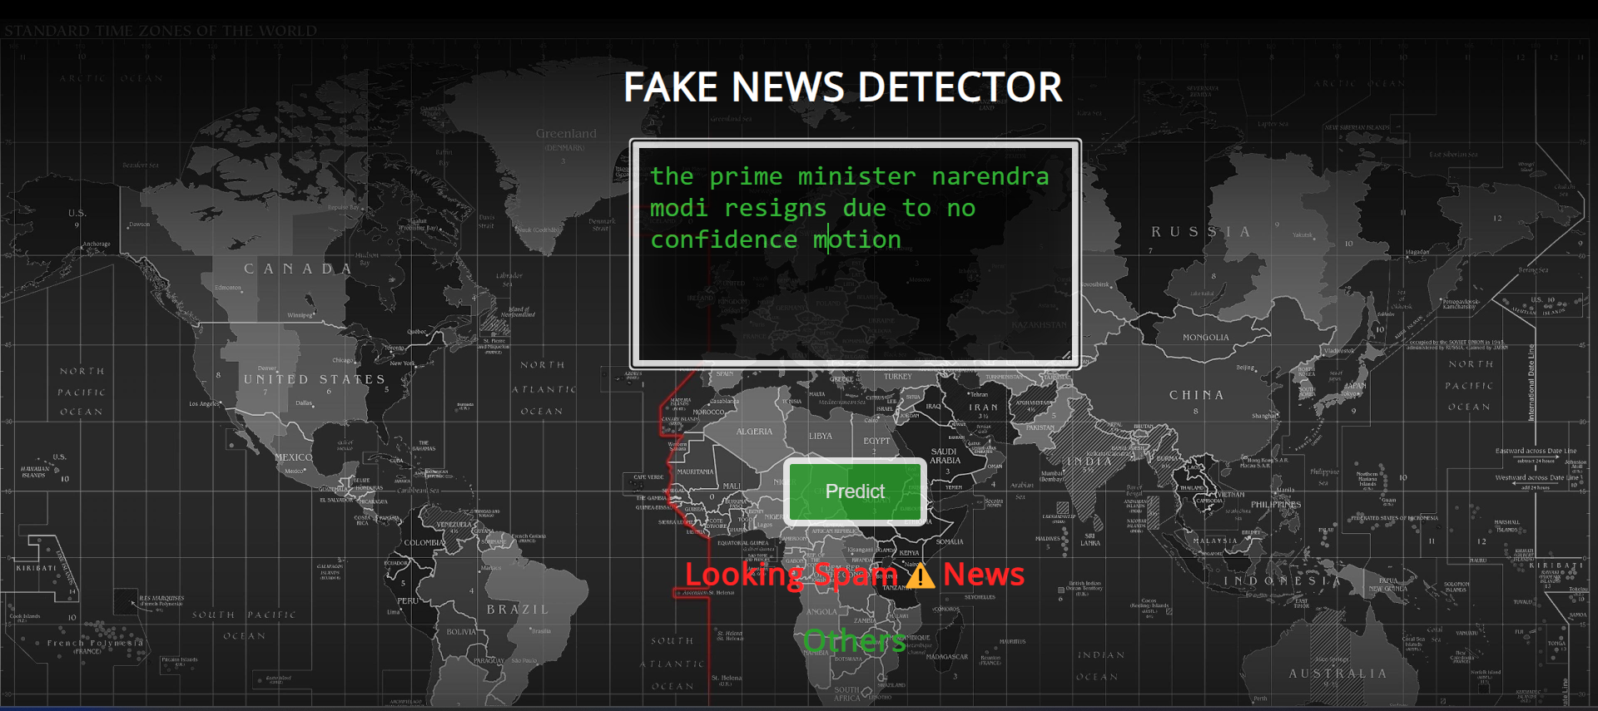
screenshot

Slide 35
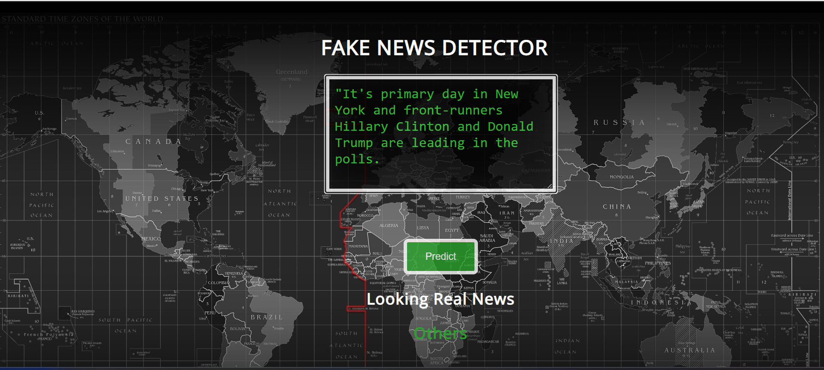
screenshot

Slide 36
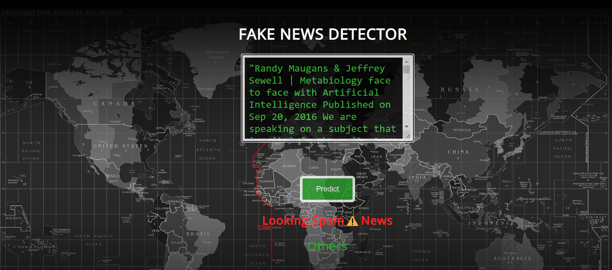
screenshot

Slide 37
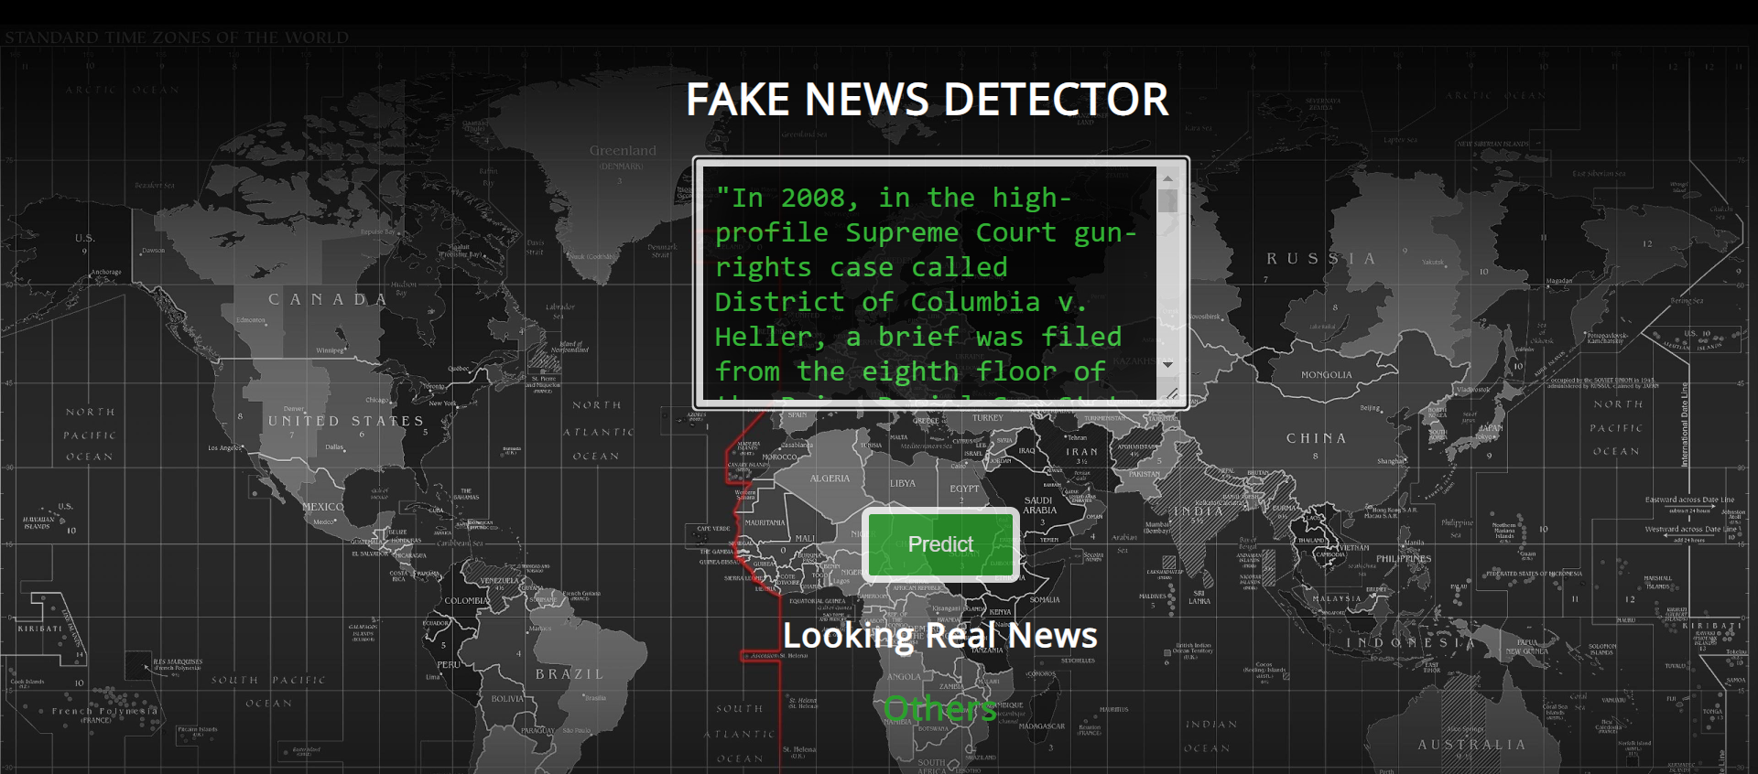
screenshot

Slide 38
CONCLUSION
We propose a novel hybrid fake news detection system in this paper that employs two types of features: linguistic and fact-verification features.
The proposed detection system achieves an accuracy of 99% under XGBoost, according to evaluation results on the News data set.
In the future, we hope to improve the detection system's accuracy by investigating other discriminating features, such as visual and style-based features.

Slide 39
ReFERENCES
[1]. S. Yang, K. Shu, S. Wang, R. Gu, F. Wu and H. Liu, &quot;Unsupervised Fake News Detectionon Social Media: A Generative Approach&quot;, Proceedings of the AAAI Conference on ArtificialIntelligence, vol. 33, pp. 5644-5651, 2019.
[2]. M. Hlaing and N. Kham, &quot;Defining News Authenticity on Social Media U sing MachineLearning Approach&quot;, 2020 IEEE Conference on Computer Applications (ICCA), 2020.
[3]. F. Ozbay and B. Alatas, &quot;Fake news detection within online social media using supervisedartificial intelligence algorithms&quot;, Physica A: Statistical Mechanics and its Applications, vol.540, pp. 123174, 2020.
[4]. P. Faustini and T. Covões, &quot;Fake news detection in multiple platforms andlanguages&quot;, Expert Systems with Applications, vol. 158, pp. 113503, 2020.
[5]. K. Yazdi, A. Yazdi, S. Khodayi, J. Hou, W. Zhou and S. Saedy, &quot;Improving Fake NewsDetection Using K-means and Support Vector Machine Approaches&quot;, World Academy of ScienceEngineering and Technology International Journal of Electronics and CommunicationEngineering, vol. 14, no. 2, 2020.

Slide 40
[6]. Y. Lin, &quot;10 Twitter Statistics Every Marketer Should Know in 2021[Infographic]&quot;, My.oberlo.com, 2021.
[7]. B. Collins, D. T. Hoang, N. T. Nguyen and D. Hwang, &quot;Trends in combating fake news onsocial media - a survey&quot;, Journal of Information and Telecommunication, vol. 5, no. 2, pp. 247-266, 2020.
[8]. J. W. Waweru Muigai, &quot;Understanding fake news&quot;, International Journal of Scientific andResearch Publications (IJSRP), vol. 9, no. 1, 2019.
[9]. L. Gimenez, &quot;6 steps for data cleaning and why it matters&quot;, Geotab, 2020.
[10]. P. S Reddy, D. Roy, P. Manoj, M. Keerthana and P. V Tijare, &quot;A Study on Fake NewsDetection Using Naive Bayes SVM Neural Networks and LSTM&quot;, Jour of Adv Research inDynamical &amp; Control Systems, vol. 11, no. 06, 2019.

